Slide 1
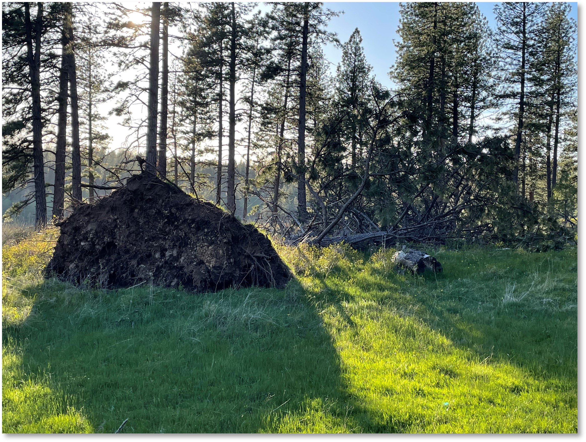
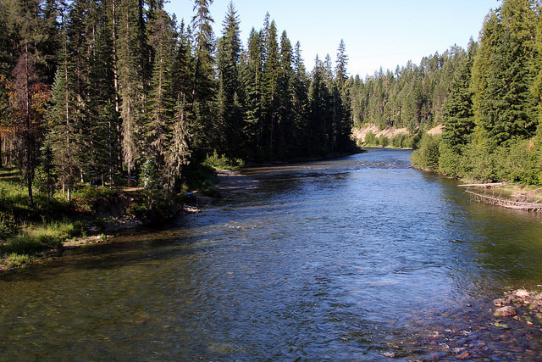

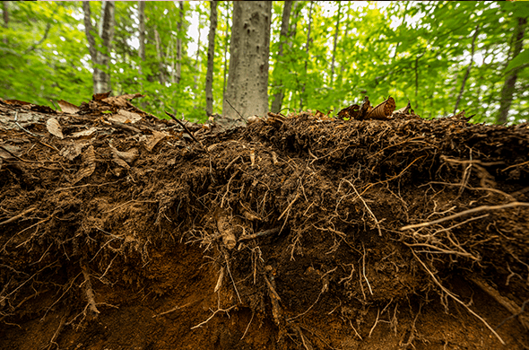
Module 2: Soil Health Resource Concerns in Forestlands
Notes:
Photo Credit: N. Sirovatka USDA-NRCS
While above ground vegetation can be put at risk of blowing over when thinning practices occur by not having the forest support to resist the wind, those blow down trees provide a repository for precipitation to collect and enter the soil profile instead of being on the landscape as overland flows.

Slide 2
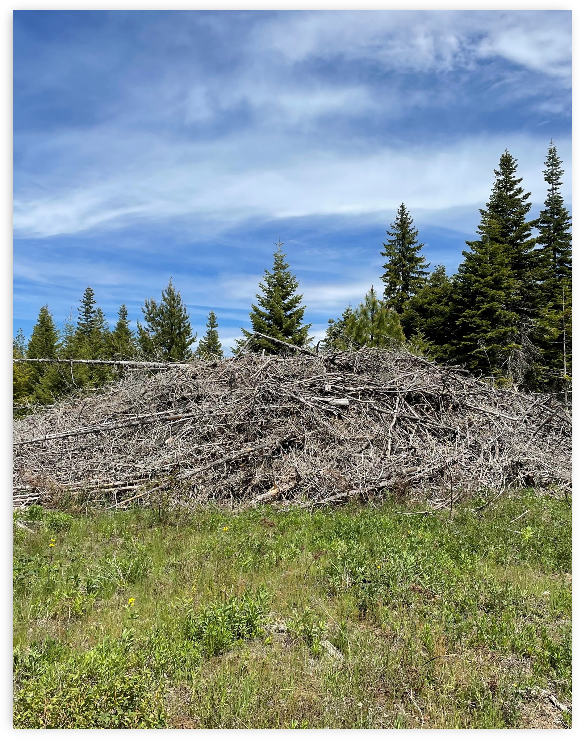
Objectives
Identify the resource concerns associated with soil health.
Correlate soil health resource concerns with forestland activities.
Identify state regulation potentials for conservation implementation.
Locate and discuss data tools and interpretations for forest soil health.
N. Sirovatka
Notes:
Photo Credit: N. Sirovatka USDA-NRCS
Management decisions in forest systems have a critical impact on the soil environment. Intense, hot burns like the one that will result from this slash pile has negative affects on forest soil life and the systems recovery.

Slide 3
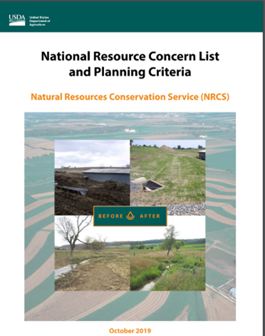
NRCS Resource Concerns
Resource Concern: An existing or expected degradation of the soil, water, air, plant, or animal resource base to the extent that the sustainability or intended use of the resource is impaired. (FOTG Section III)
Soil Health Resource Concerns:
Compaction
Organic matter depletion
Soil organism habitat loss or degradation
Aggregate instability
…and let’s discuss Soil Erosion
Notes:
The key soil health resource concerns are…, these can be root cause problems for many other resource concerns. These are tied to very important soil functions, so we are assessing indicators of loss of key soil functions

Slide 4
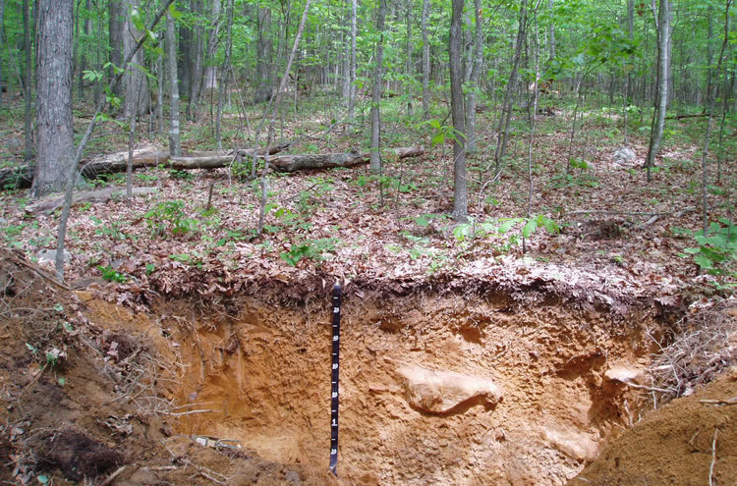
Soil Health Resource Concerns
Compaction (CPT)
Description: Management induced soil compaction at any level throughout the soil profile resulting in reduced rooting depth/structure, plant growth, biological activity, infiltration, etc.
Objective of Evaluation: If the CPT Resource Concern scores <3 for Soil Cover AND <15 for the sum of all other CPT Indicators, the CART Score will be "Does Not Meet". However - If the soil surface layer (and/or depth to 30 cm (12 in)) has a natural platy soil structure as documented by the soil survey, the planner may choose to override this rating by following footnote 1/, giving the Soil Structure indicator a score of 5, while considering the other CPT Indicator ratings
Photo 1: U.S. Forest Service
Photo 2: USDA-NRCS
Notes:
Photo 1: USDA Forest Service - Soils
Photo 2: Eunice Padley- NRCS USDA

Slide 5
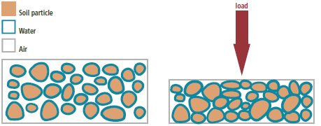
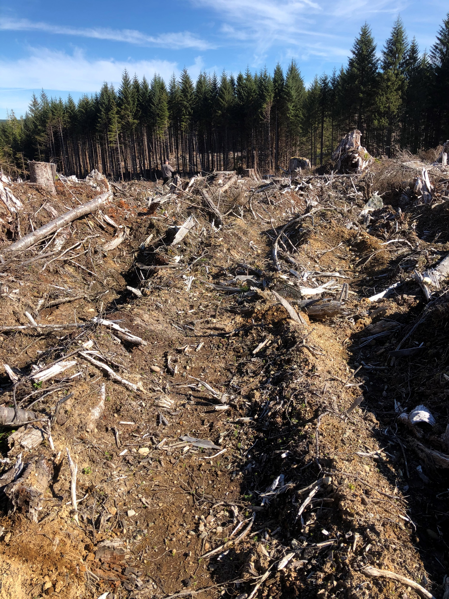
--Compaction of Forest Soils--
Graphic: Soil Compaction-CAFRE
Increase in bulk density from loads applied to the soil.
Caused by movement of heavy equipment during felling, processing, forwarding, skidding and site preparation.
Soil volume decreased by compression of macropores.
Inhibits root access to gas exchange –impacts seedling establishment and tree growth.
Slows moisture infiltration and drainage
Degree and duration of compaction, and effects on tree growth, are dependent on climate, moisture regime, soil texture, structure, and organic matter content.
U.S. Forest Service
Slide modified from “Managing Soil Quality in Forests” –Eunice Padley NRCS National Forester (Presented June 14, 2016)
Notes:
Compaction Graphic Credit: Soil compaction | Dairy farmers |CAFRE | Greenmount – CAFRE
Photo Credit: U.S. Forest Service

Slide 6
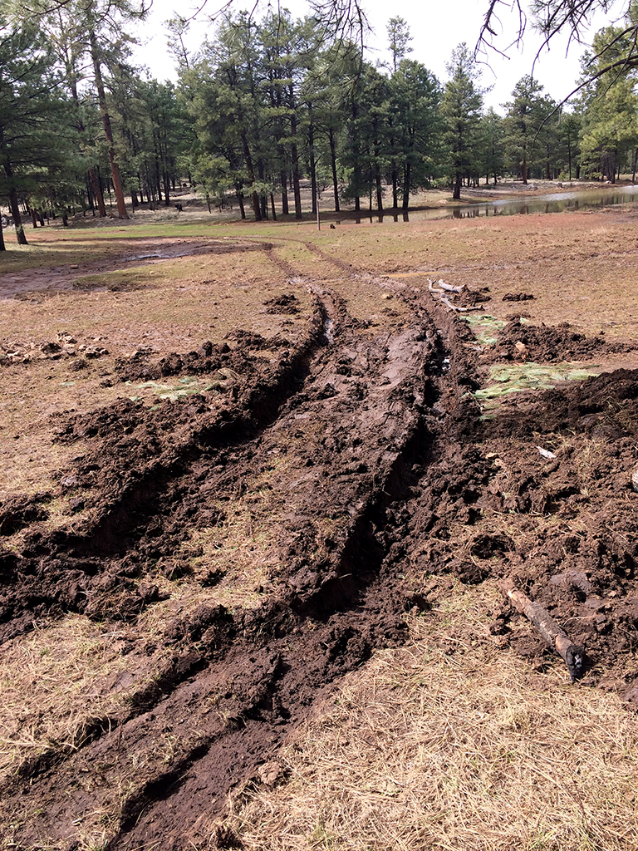
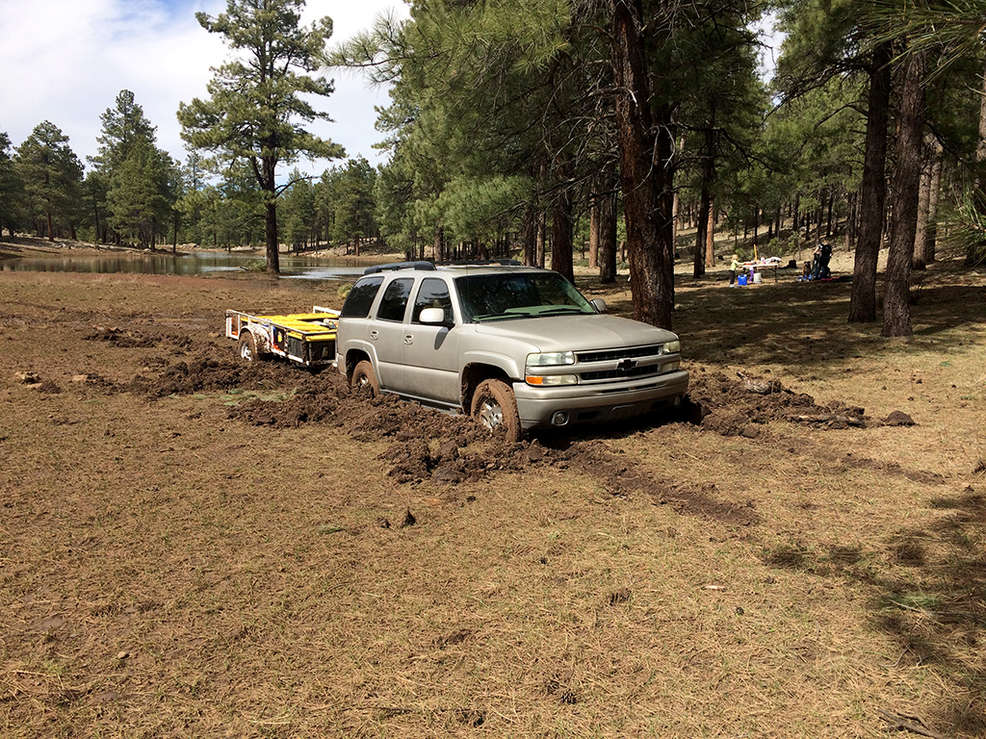
Regardless what your kids tell you -Ruts are not fun-
Ruts- made by equipment or vehicles occur when soil strength isn’t able to support the machines
Surface water flows are altered and can lead to ponding.
Rutted areas can lead to increasing intensity of erosion
Rutting can lead to root damage which decreases the viability of the above ground biomass
Photo Credit: USFS- Coconino NF
Notes:
For anyone with a teenager; especially one who is newly allowed to drive, the allure of “mudding” is almost a right of passage. Equipment used in forestry can be just as damaging, if the timing of use doesn’t take into account the soil environment and conditions.
We don’t always work with land owners who are utilizing the forest for timber harvests. Critical damage can be done to forest soils in the mosaic patterns of vegetative growth when access occurs during periods of high saturation.

Slide 7
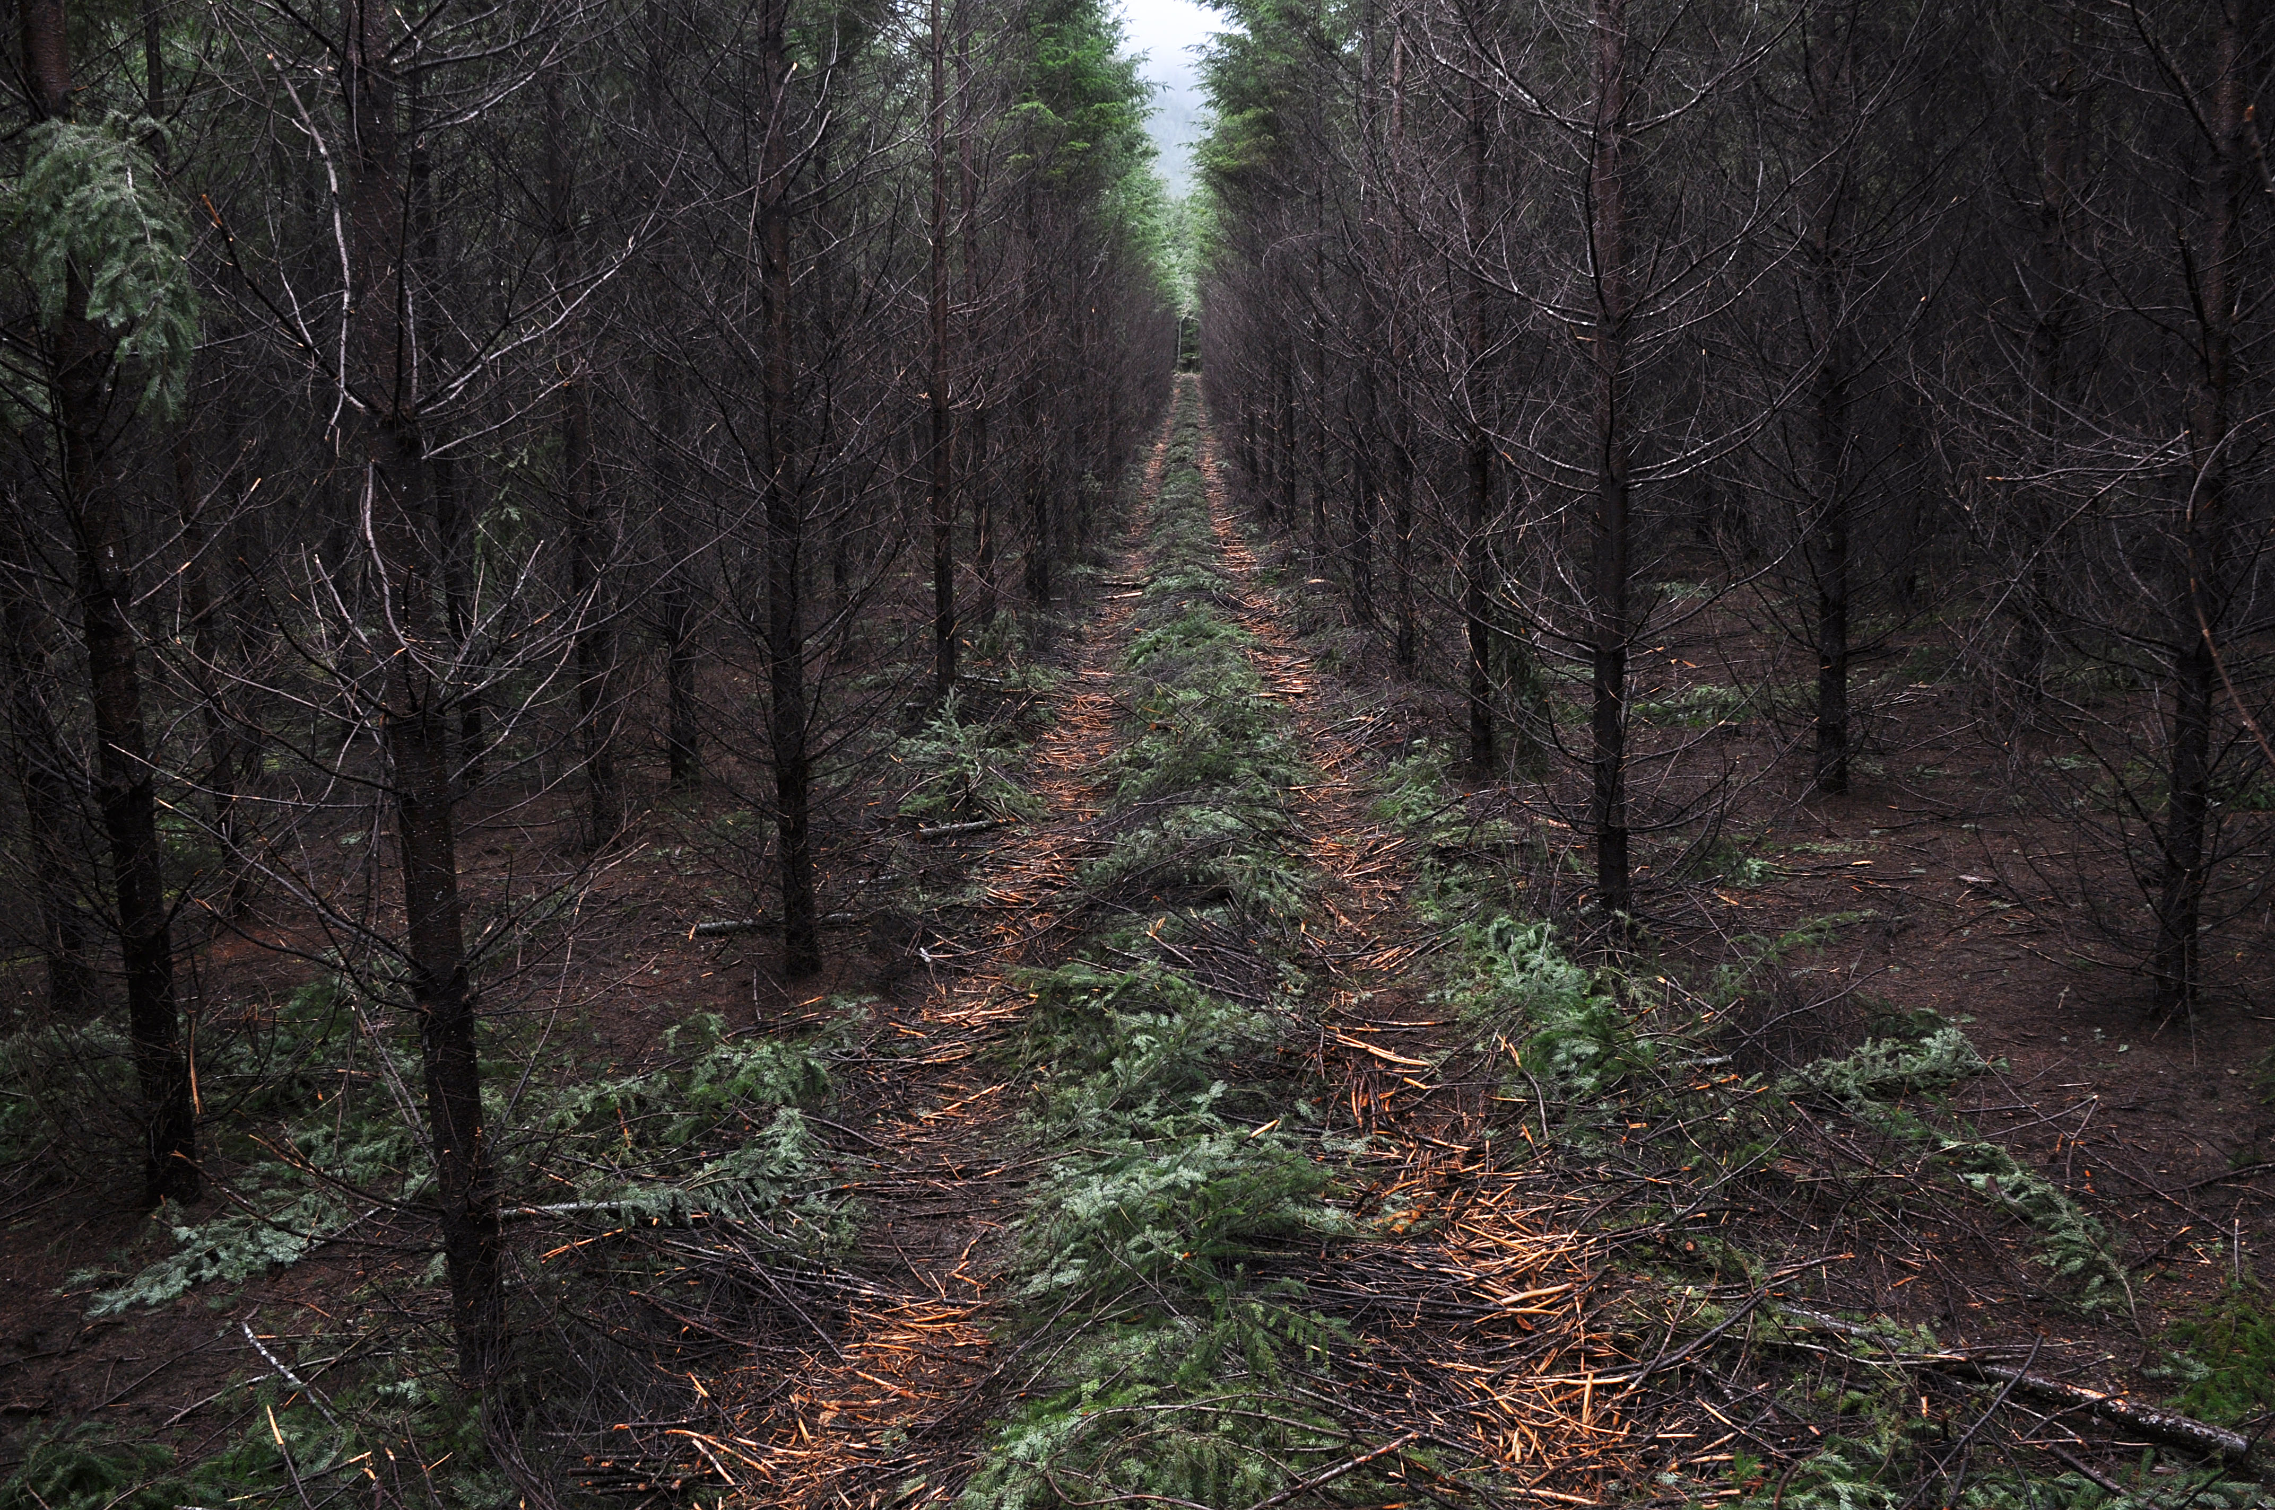
Avoiding Compaction
Protect the forest floor
  Operate on slash
  Minimize heavy equipment footprint in the forest
Reduce risk of erosion
Time forest practices to target periods where soil moisture isn’t excessive.
Identify and utilize roads and landings to reduce traffic and disturbance on vulnerable soils.
Photo credit: USDA-NRCS Oregon via Flickr
Notes:
Protecting the forest floor is a broad statement. Managing the O horizon, the duff layer and the biomass above ground are all critical activities included in avoiding compaction.

Slide 8
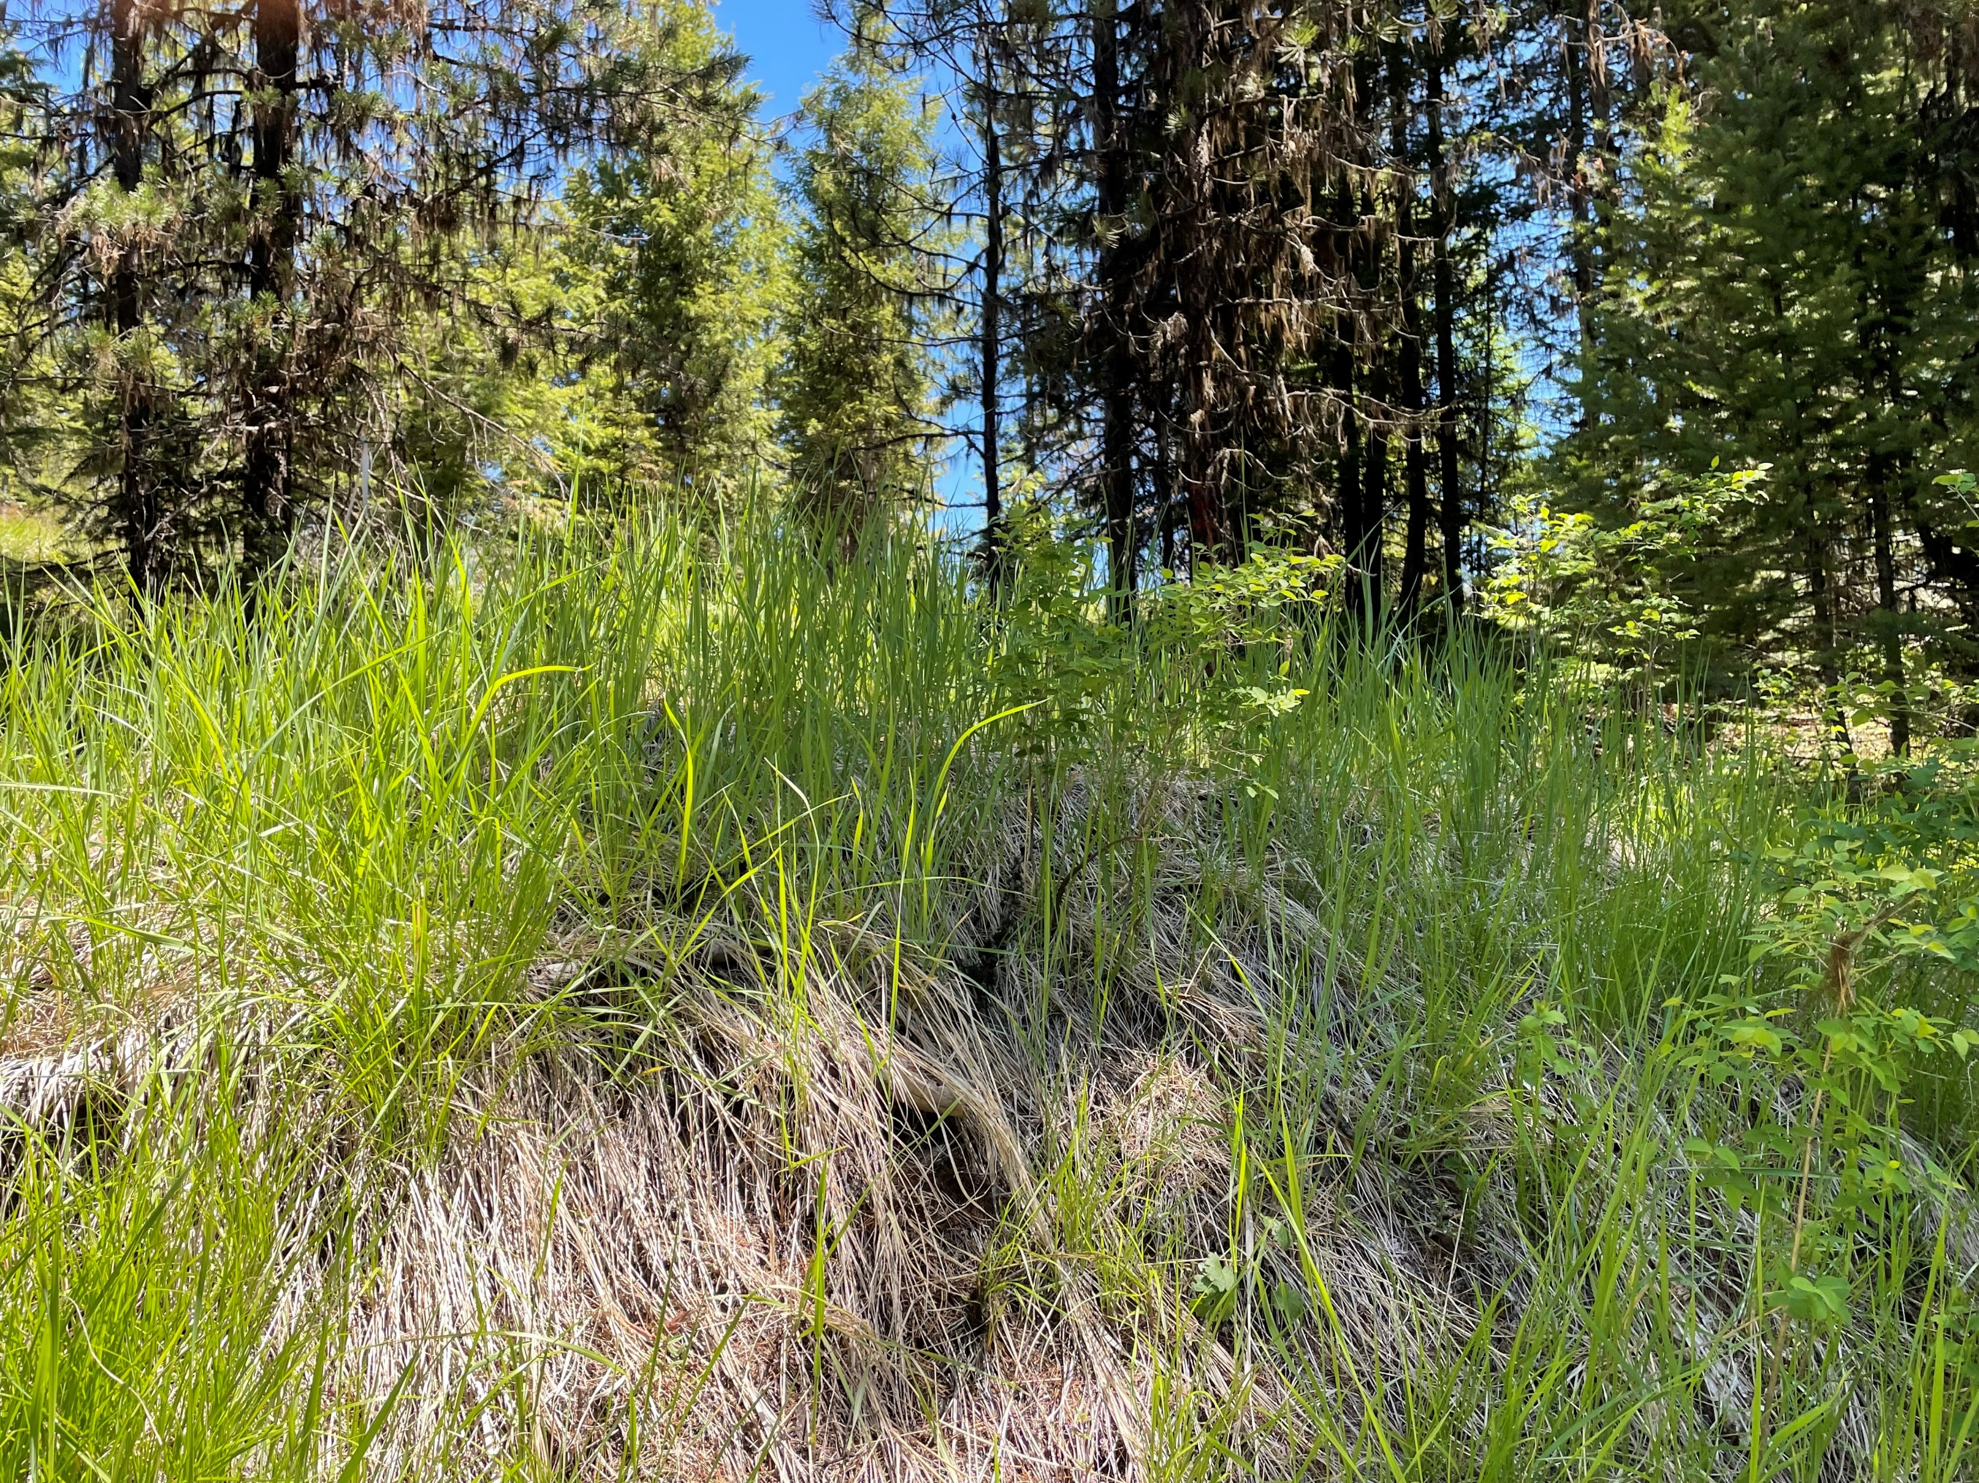
Soil Health Resource Concerns
Organic Matter Depletion (SOM)
Description: Management induced depletion of any or all soil organic matter pools (e.g., labile carbon, total soil carbon or nitrogen) resulting in limited soil function and processes that support: plant growth; habitat/food for soil organisms; water/nutrient cycling.
Objective of Evaluation: If the SOM Resource Concern scores < 5 on either of the following indicators, the CART Score will be "Does Not Meet": Soil Cover; Woody Debris
Notes:
Photo credit: N. Sirovatka USDA-NRCS
There will be additional modules discussing benefits to management of organic matter including carbon sequestration and nutrient/water holding capacity.

Slide 9
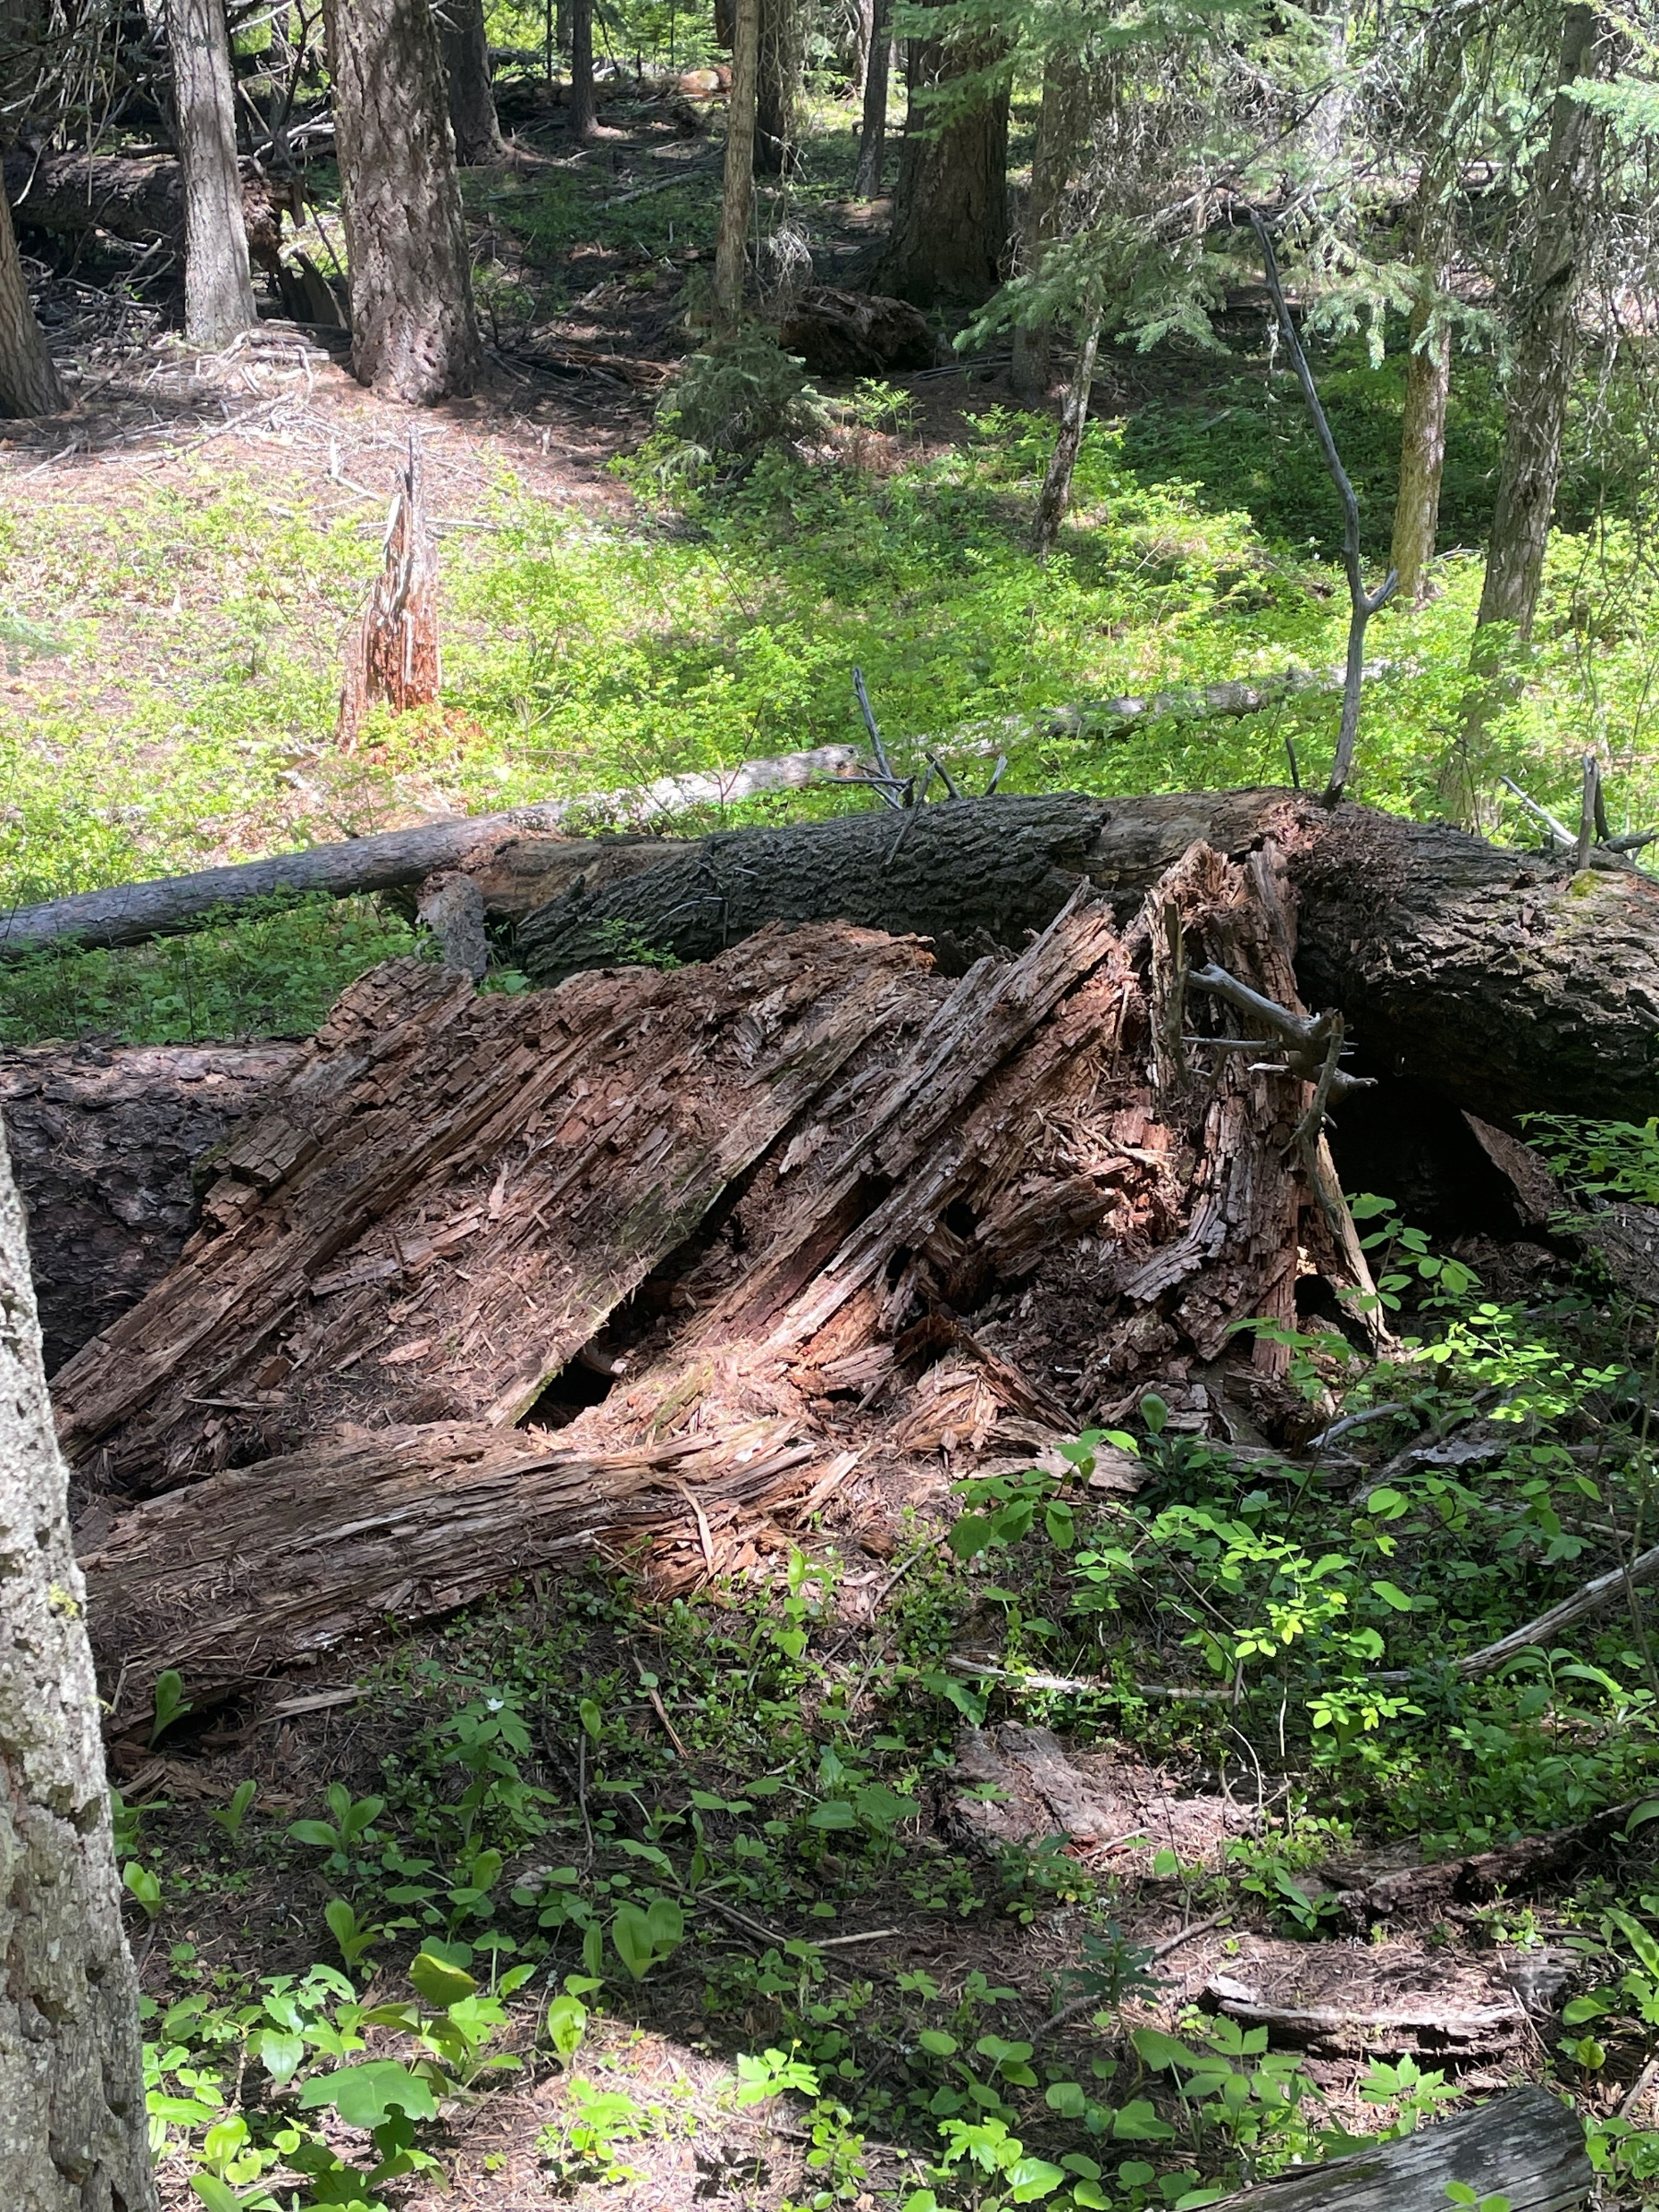
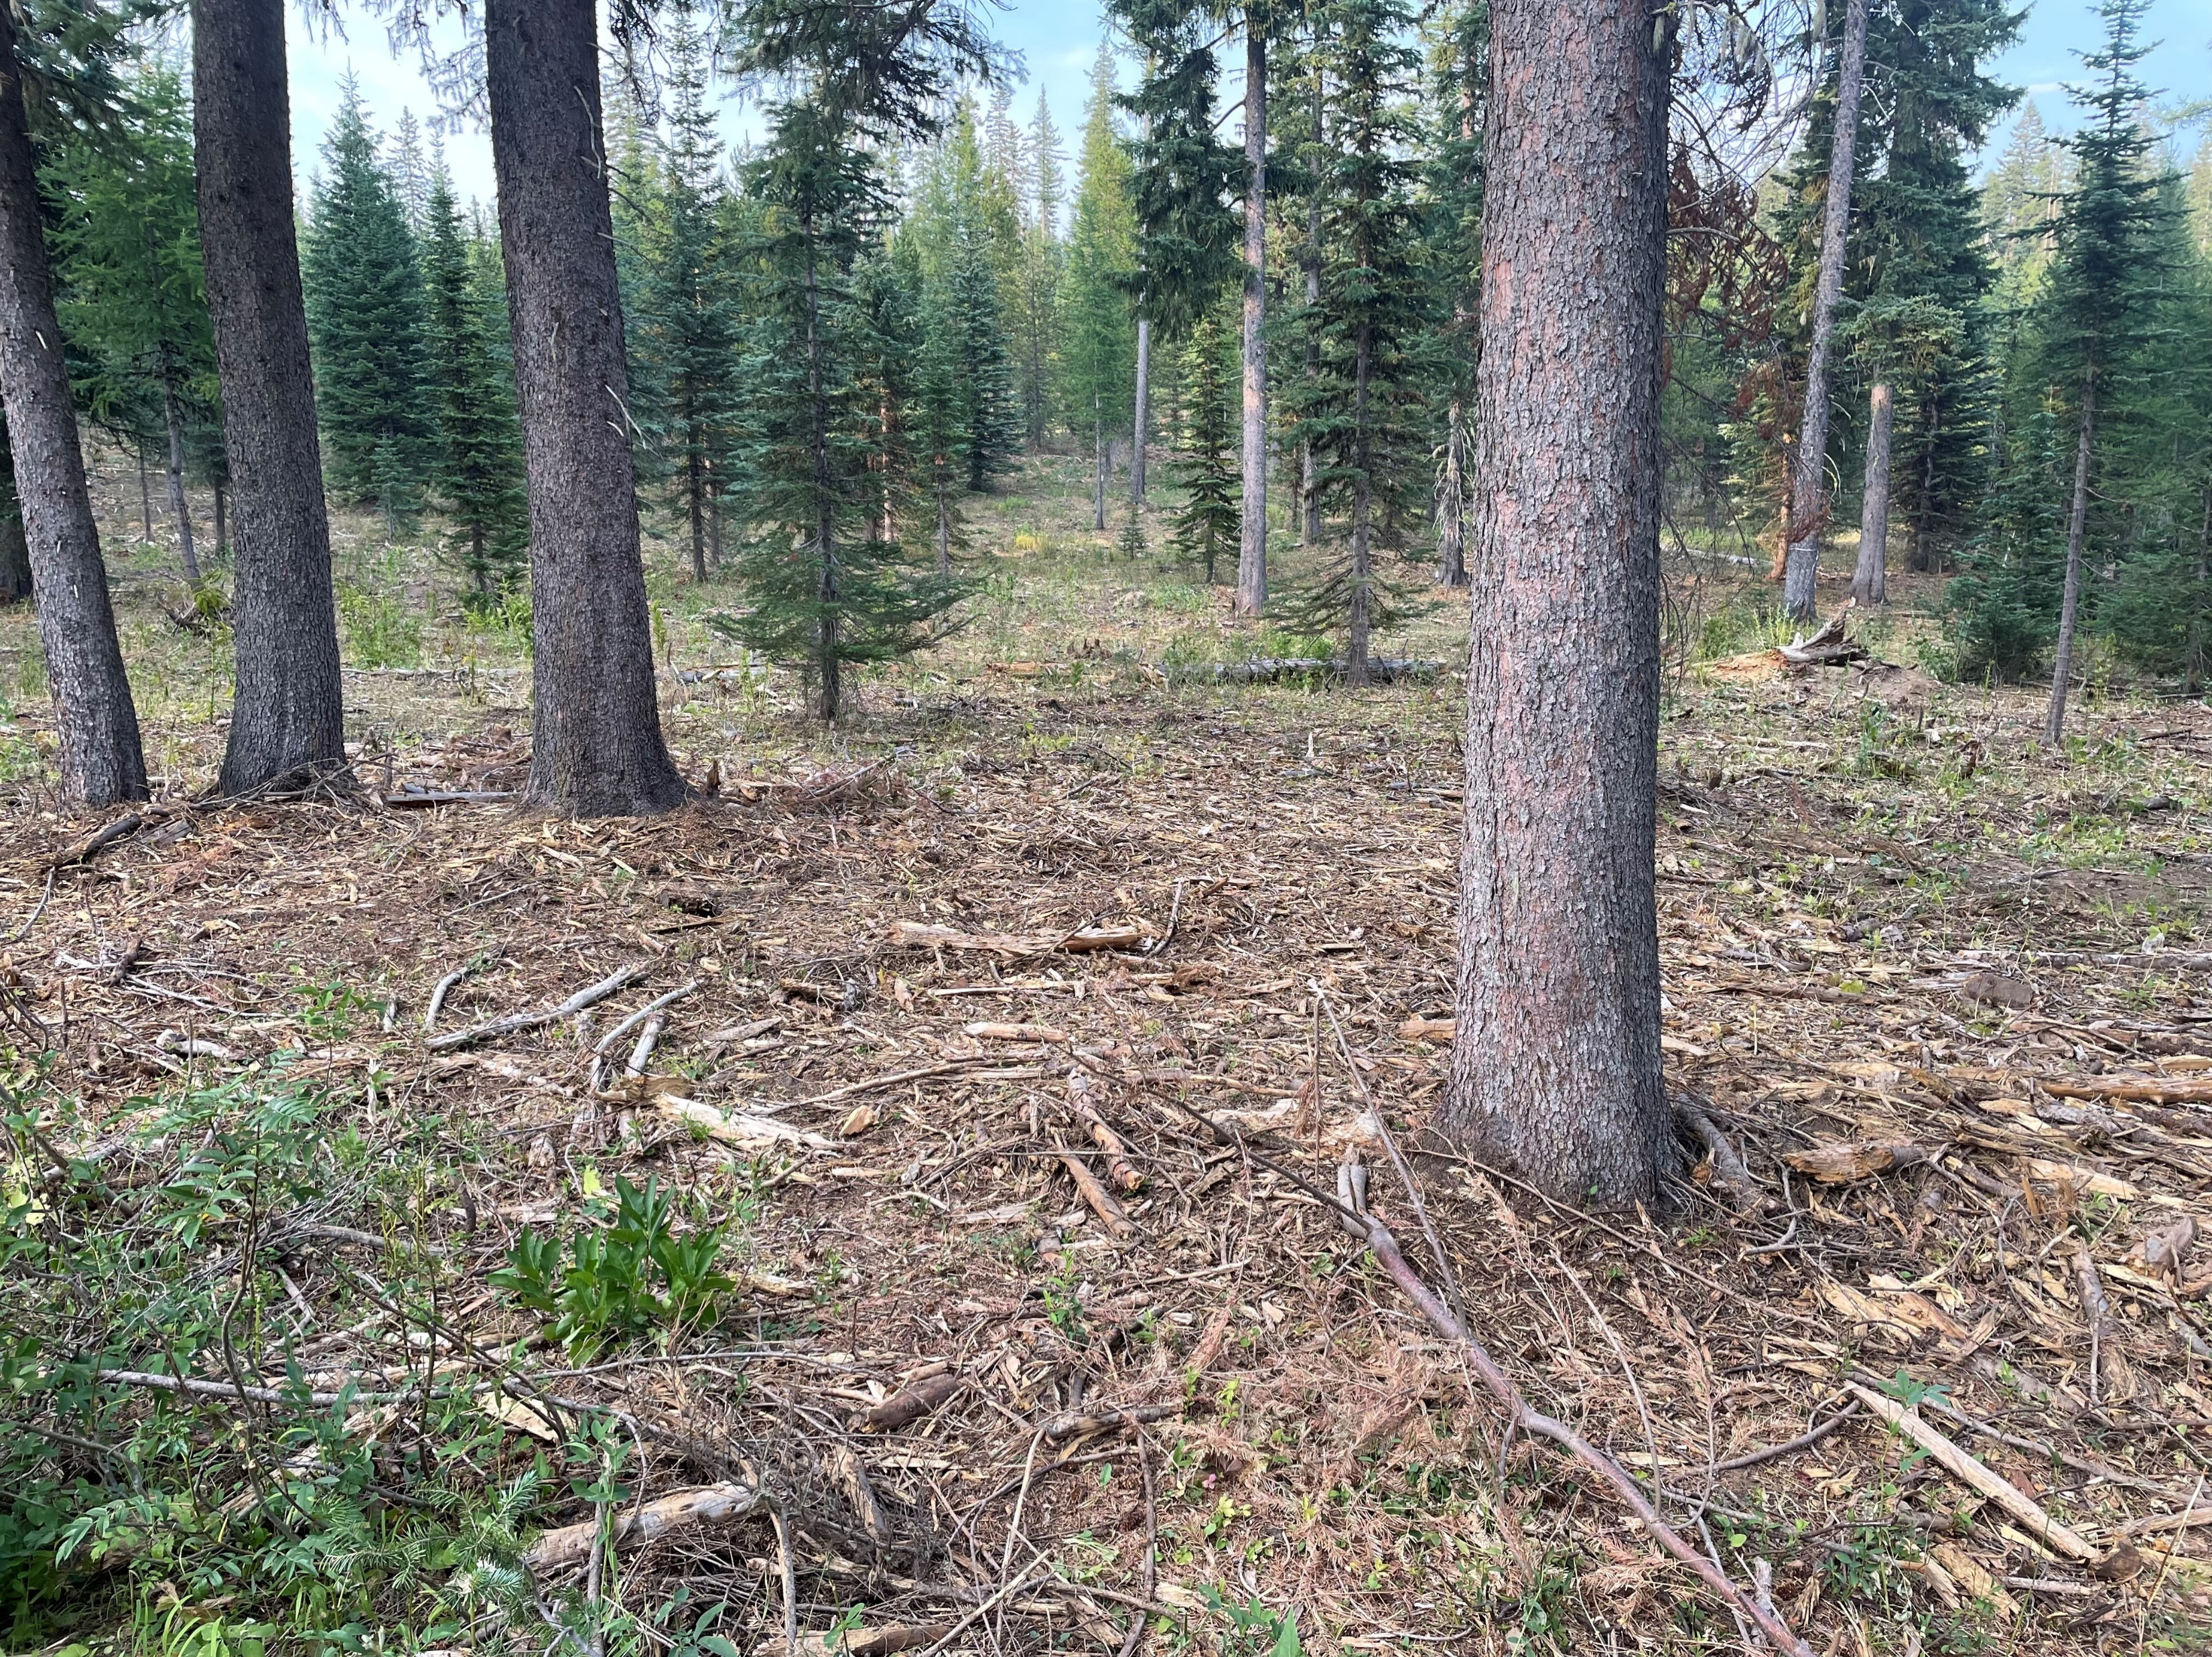
Protection and Management of Organic Matter
Protection of the surface layers of forest soils provide vital services to the health of the forest soil.
Ensuring organic matter is available to continue the cycling of nutrients.
Organic matter provides vital food sources for microbial populations.
Organic matter is vital for water holding capacity.
Provides buffers for temperature fluctuations in the soil.
Notes:
Photo Credits: N. Sirovatka USDA-NRCS

Slide 10
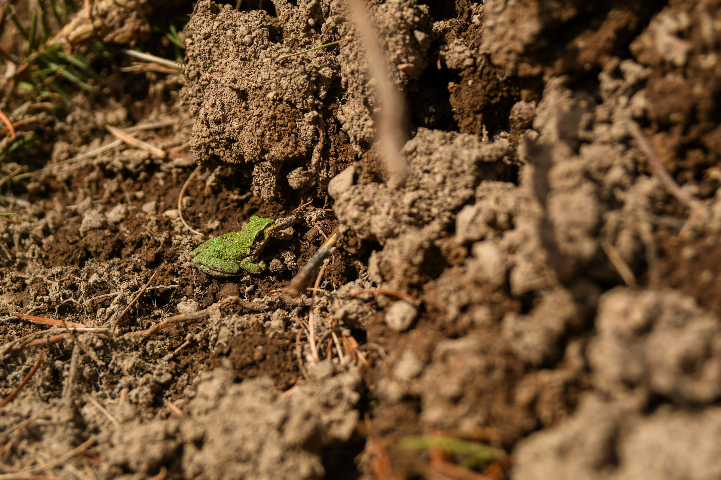
Soil Health Resource Concerns
Soil Organism Habitat Loss or Degradation (HAB)
Description: Quantity, quality, diversity or connectivity of food, cover, space, shelter and/or water is inadequate to meet requirements of soil organisms.
Objective of Evaluation: If the HAB Resource Concern scores < 5 on either of the following indicators, the CART Score will be "Does Not Meet": Woody Debris; Soil Fauna/Biological Diversity
Photo Credit: Oregon NRCS via Flickr

Slide 11
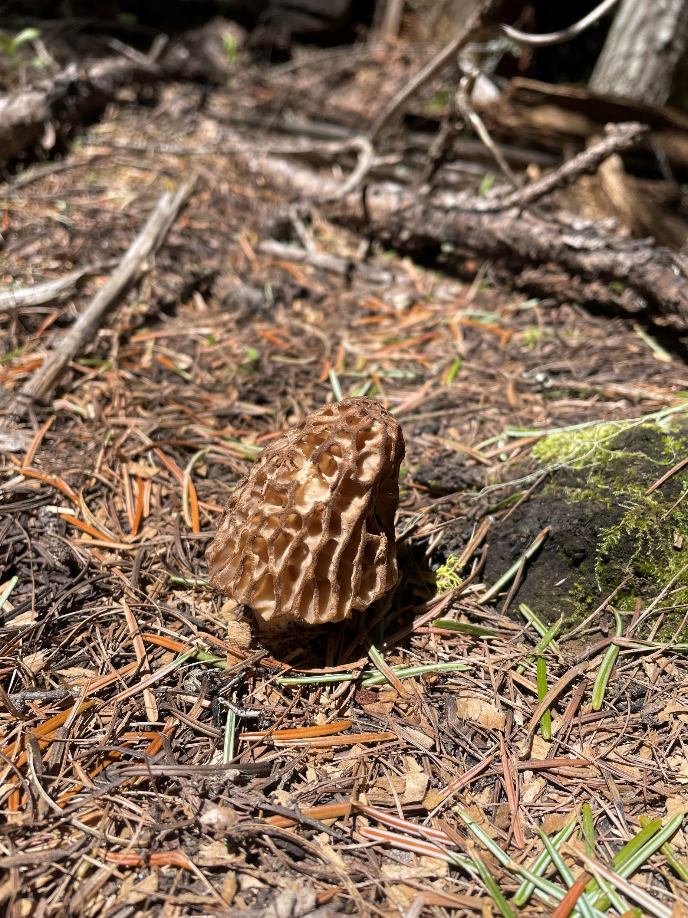
Manage for the forest soil organisms
Maintain texture and structure which provides for aeration and water movement.
Ensure cycling opportunities for organic matter and nutrients.
Keep soil in place to maximize rooting zone depth.
Protect the soil from damage by organic matter (duff).
Notes:
Photo Credit: N. Sirovatka USDA-NRCS

Slide 12
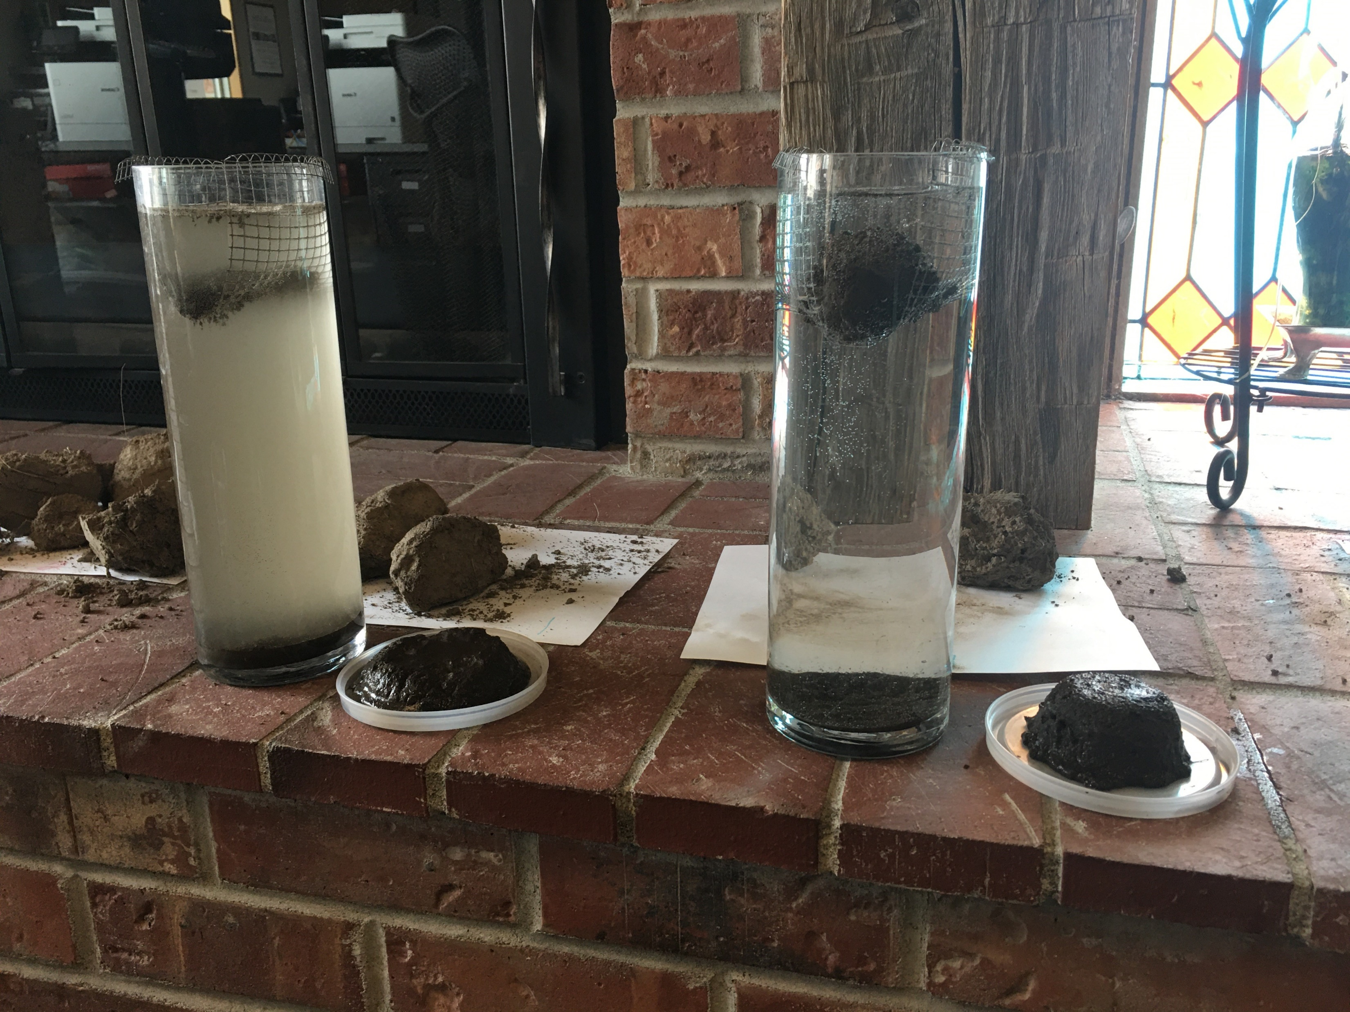
Soil Health Resource Concerns
Aggregate Instability (AGG)
Description: Management induced degradation of water stable soil aggregates resulting in: reduced infiltration, water holding capacity and soil habitat; increased ponding, flooding, erosion; plant stress; depressed resilience to weather extremes.
Objective of Evaluation: If the AGG Resource Concern scores < 5 on any of the following indicators, the CART Score will always be "Does Not Meet": Water Stable Aggregates; Soil Structure; Soil Disturbance Intensity; Soil Burn Severity.
Photo: Cropland soil stability (L) Forestland soil stability (R)
Notes:
Photo Credit: N. Sirovatka USDA-NRCS

Slide 13
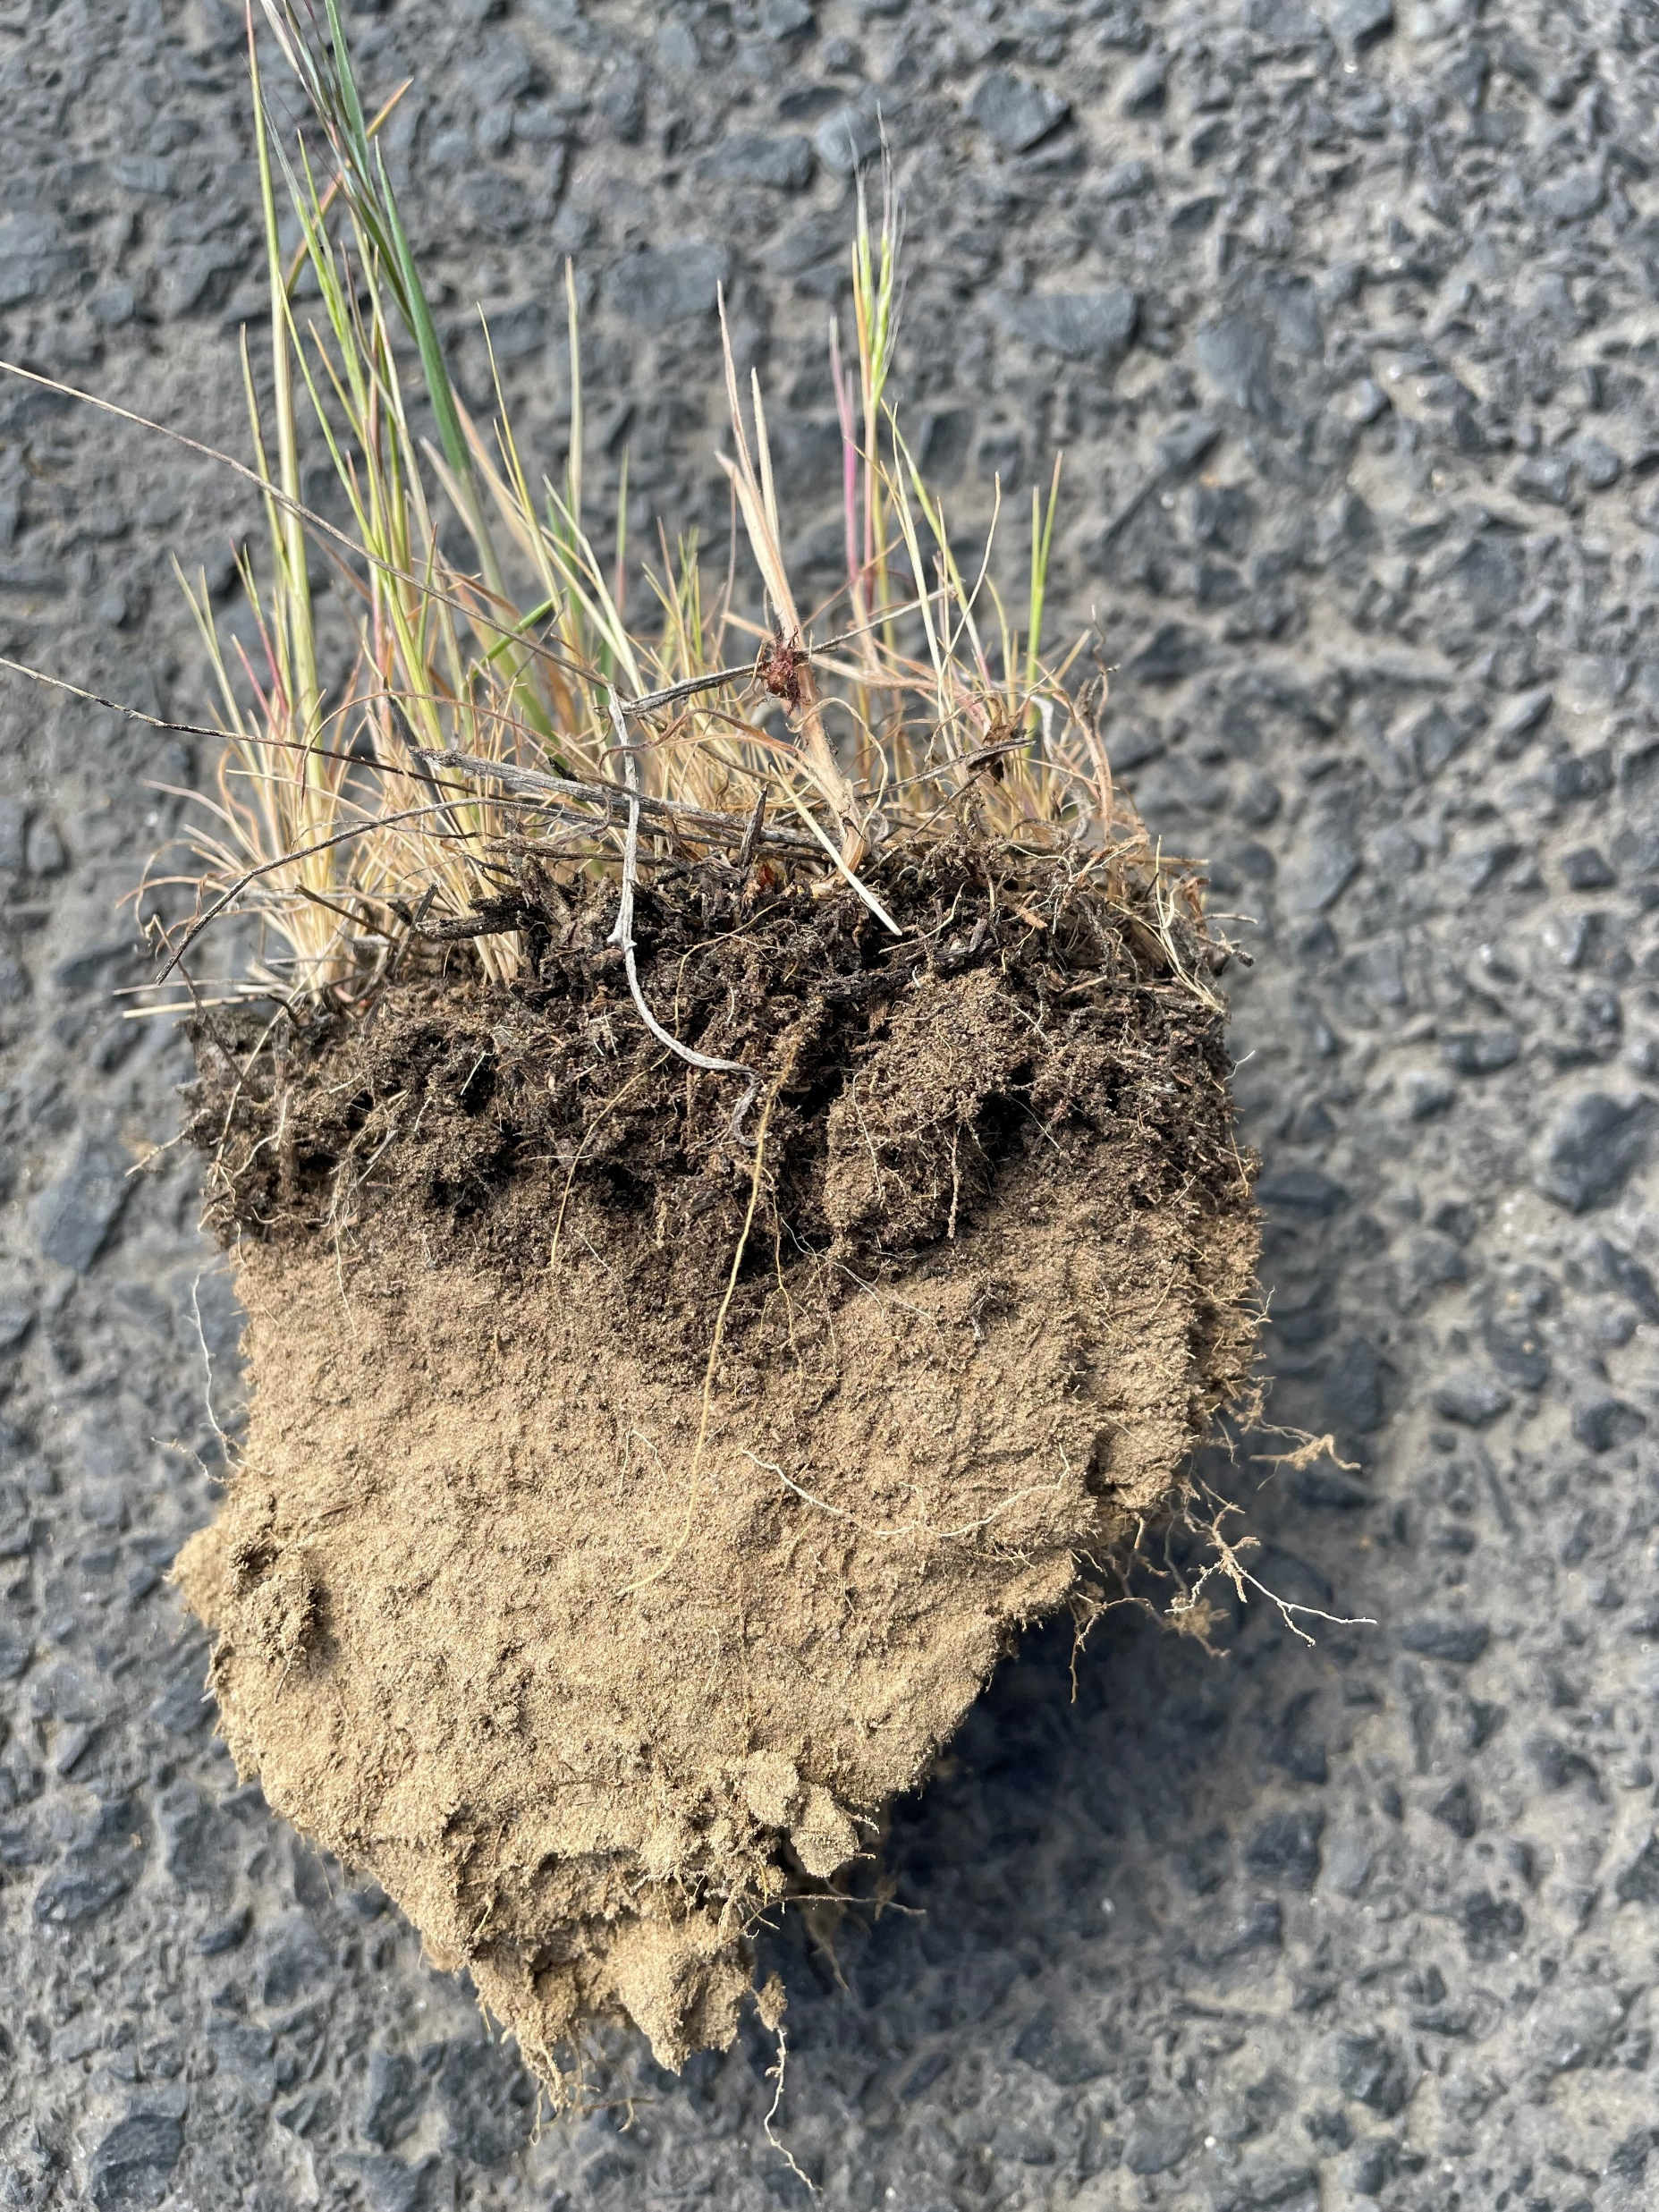
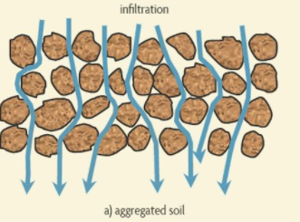
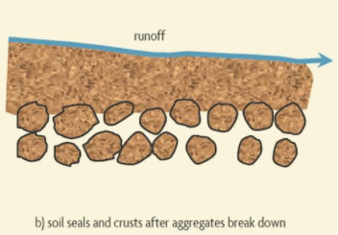
Aggregates as an indicator of soil health
Just as in other land uses - the soil aggregate is an excellent indicator of overall soil health.
Used as a field demonstration instead of a lab test- aggregate stability provides NRCS a useful tool to communicate how management decisions impact the overall health of the soil environment.
Notes:
Photo Credit: N. Sirovatka USDA-NRCS
Graphic: Soil Health & Sustainability for Field Personnel

Slide 14
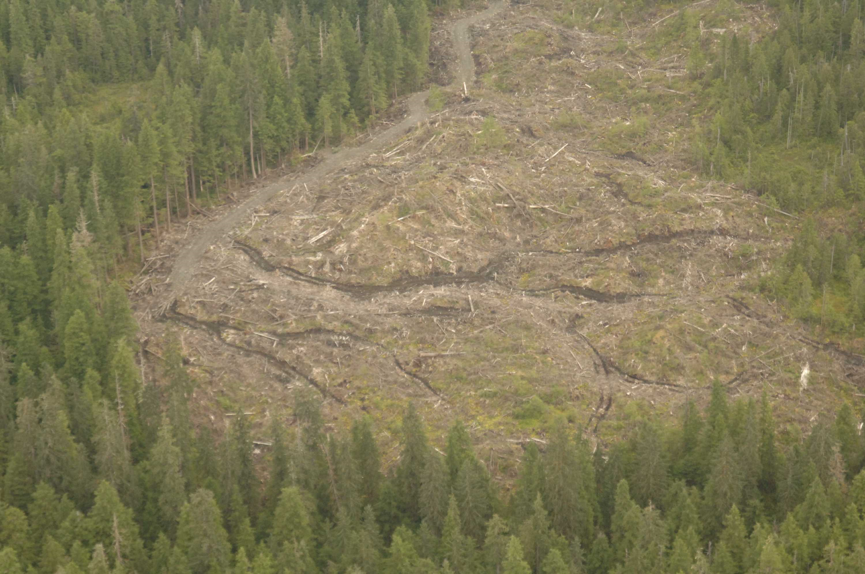
Soil Health Resource Concerns
Erosion
Soil erosion isn’t specifically a “Soil Health” Resource Concern in the scope of NRCS, but keeping the soil in place and protected is critical to ensuring soil health.

Slide 15
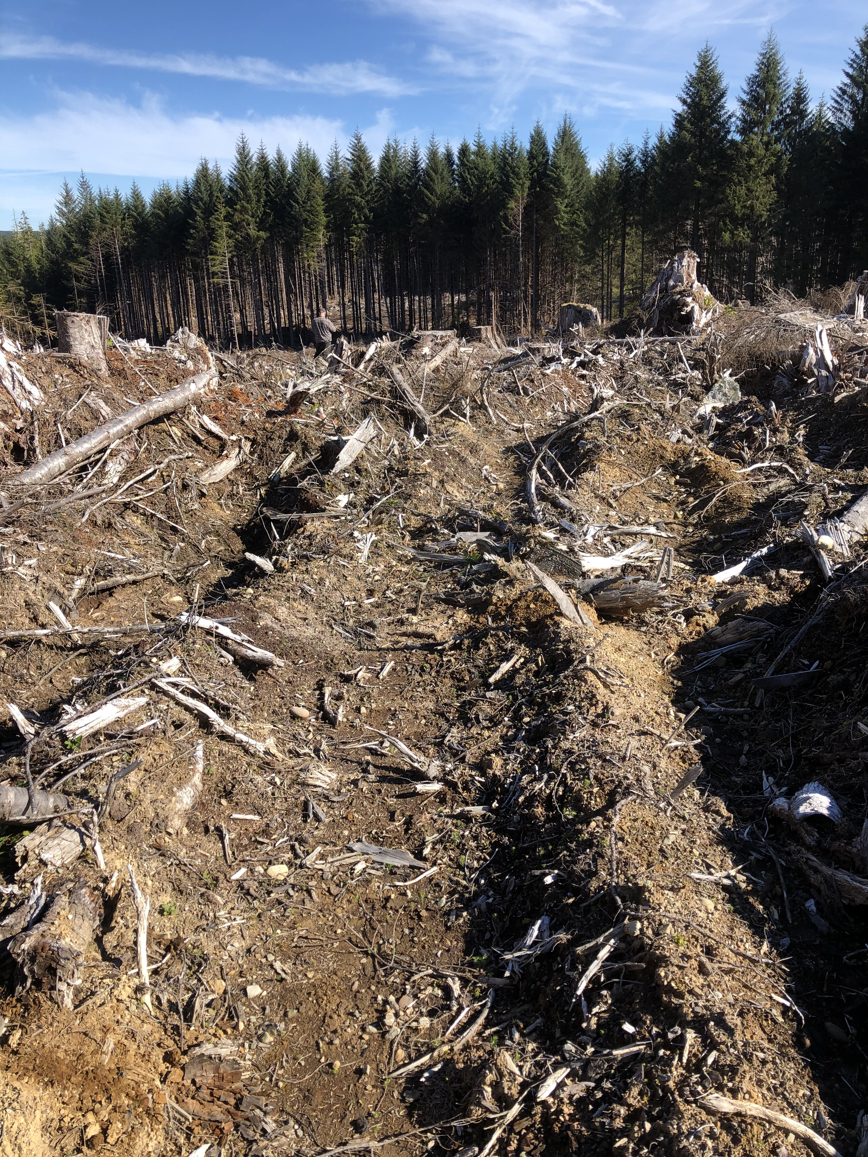
Soil erosion in forests is a critical issue
-Minimize the disturbance-
Roads and trails are a major source of soil erosion.
Steep topography and shallow soils have a critical need for protection.
During management activities and mechanical operations- soil can be damaged and exposed; leading to slow site regeneration due to loss of nutrients, organic matter and soil biological activity.
Notes:
Photo Credit: U.S. Forest Service
The planning for access roads and trails should be done scientifically to reduce the impact of erosion potential across the landscape.
Erosion has a negative effect on the localized site, as well as the lands and waters down slope

Slide 16
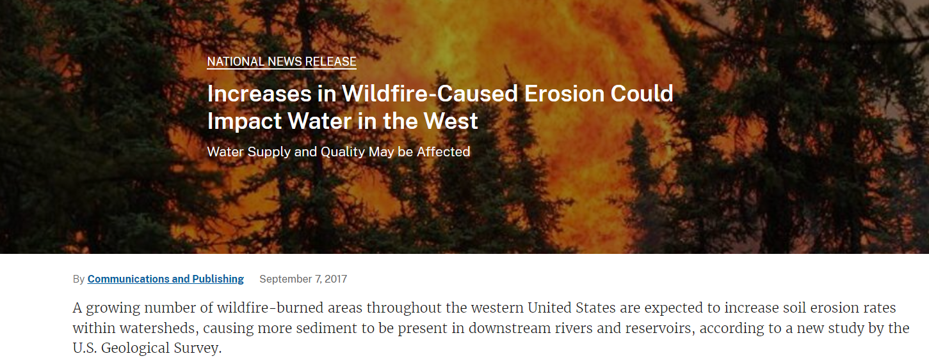
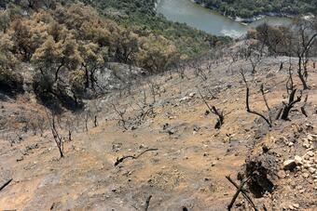
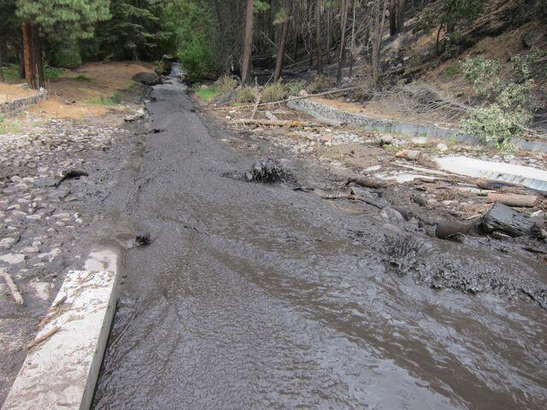
Intensity of fire has a broad reaching affect on soil health resource concerns from increased erosion potential to loss of soil organic matter to soil organism habitat loss and degradation.
Notes:
Photo 1: Potential sediment erosion from a burned slope | U.S. Geological Survey (usgs.gov)
Photo 2: Ash and sedimentation saturating a stream in Las Conchas, New Mexico. | U.S. Geological Survey (usgs.gov)
More about Fire in a later module- but the impact of wildfire is broad in scope and can affect soil health from soil displacement

Slide 17
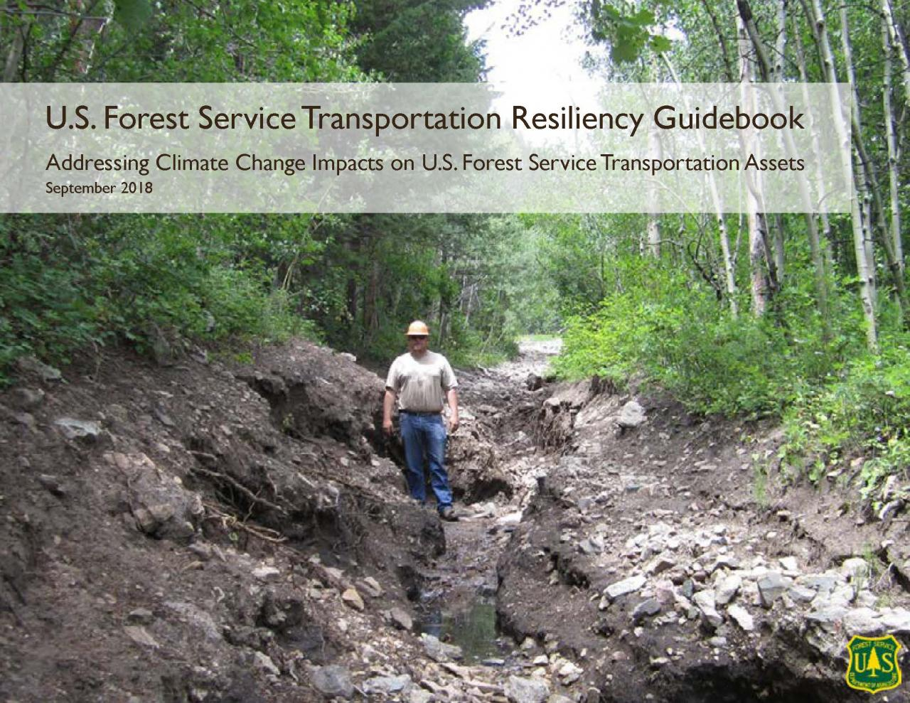
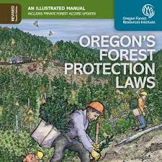
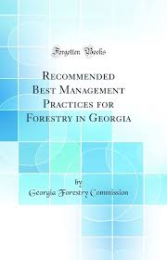
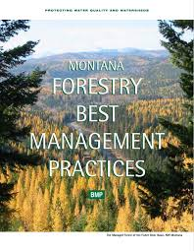

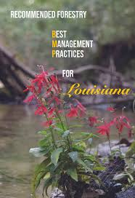

State/Federal Regulations and Guides
As NRCS employees, we need to be aware of the impact resource concerns seen in upper elevations may have on lower elevations. There are state and federal regulations that we must acknowledge in the duties of our job. Our Implementation Requirement Sheets should call out that requirement.

Slide 18
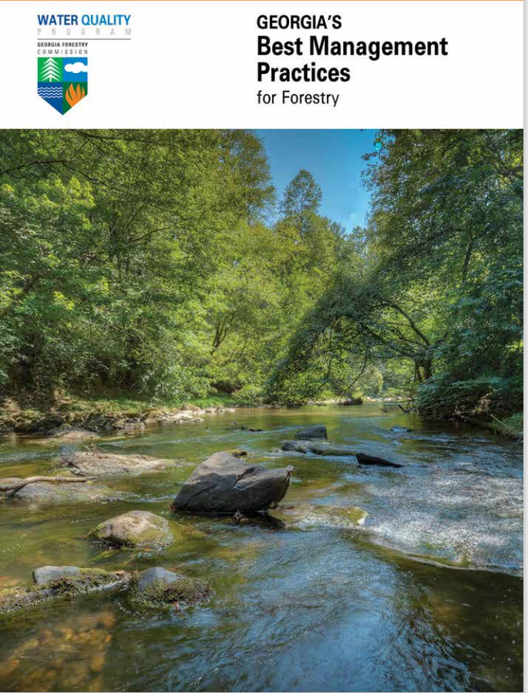
Best Management Practices (BMP)
Preventative measures that help control soil erosion as a result of human activity or disturbance.
BMP’s help divert surface water into undisturbed areas to reduce flow rates that cause rill erosion events.
--Examples include--
Correctly Planned and Installed Roads
Water Bars
Diversion Ditches
Correctly Sited and Developed Log Landings
Stream Buffers and Management Zones
Stream Crossings

Slide 19

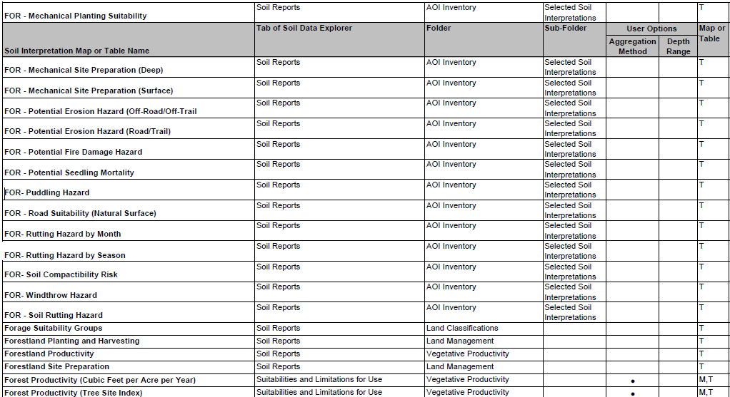
Tools and Interpretations
Other interpretations also Available:
Construction Limitations for Haul Roads/Log Landings
Displacement Hazard
Drought Vulnerable Soils
Harvest Equipment Operability
Log Landing Suitability
Notes:
KNOW BEFORE YOU GO!! These tools on web soil survey can be looked at for your area of interest before you go out to the field. They are commonly used in the development of IR strategies; and they may have a direct impact on soil health if they are not considered.

Slide 20

NRCS in the Forest- a tool for soil health
We will be introducing you to the "Forestland In-Field Soil Health Assessment" (FIFSHA) tool during this course.
  You will see that we evaluate eight indicators to identify four soil health resource concerns.
  Using this tool will allow planners to evaluate the site and have documentation for their Inventory and Evaluation requirements of the planning process.
Notes:
You should all be familiar with the SHD evaluation tools- we look at indicators to determine the resource concerns and then have practices that can be utilized to address those concerns. These tools can also be used by planners to support their I&E Requirements of the planning process. The FIFSHA tool provides that step by step evaluation and documentation- helping planners work with landowners to both evaluate and inform how improvements can be made.
Indicators: Soil Cover/ Woody Debris/ Soil Burn Severity/ Soil Disturbance Intensity/ Soil Structure/ Water Stable Aggregates/ Soil Fauna & Biological Diversity/ Roots
RC's: Aggregate Instability (AGG) / Compaction (CPT) / Soil Organism Habitat Loss or Degradation (HAB) / Organic Matter Depletion (SOM)

Slide 21
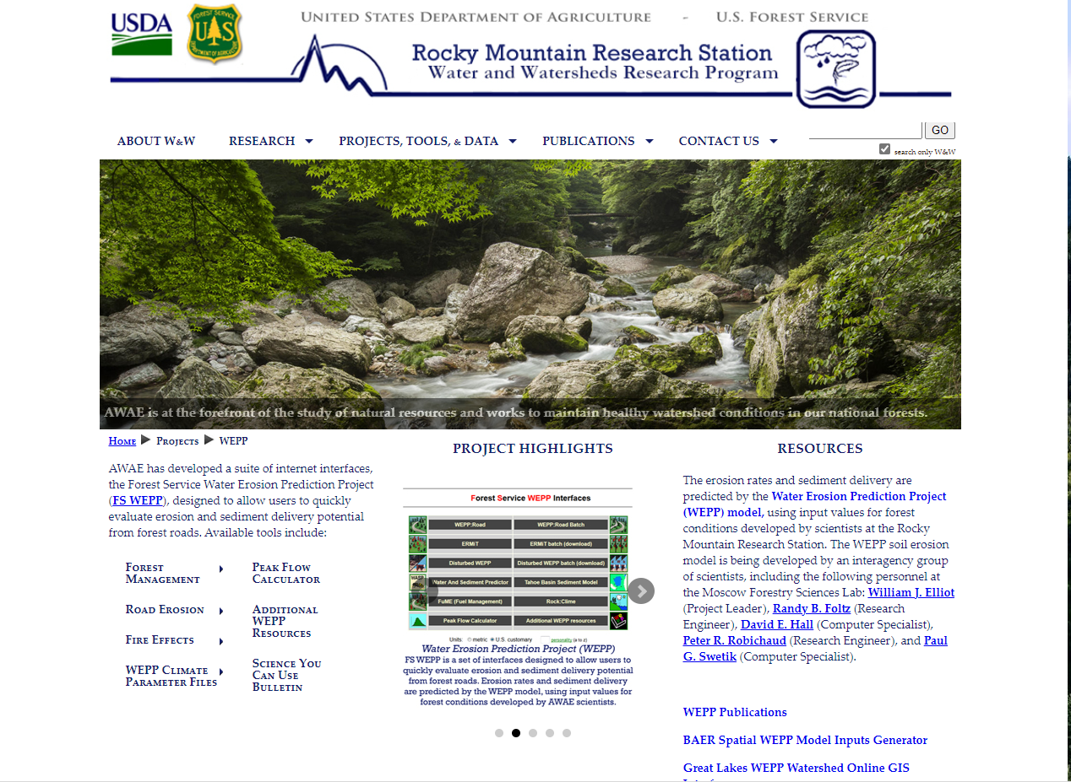
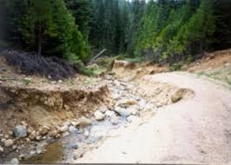
Finding the Information
Other prediction tools beyond what can be found in web soil survey are available.
Water Erosion Prediction Project (WEPP) | Water and Watersheds (W&W) Program - USDA Forest Service Science - RMRS
Notes:
Photo Credit: USDA Rocky Mountain Research Station

Slide 22
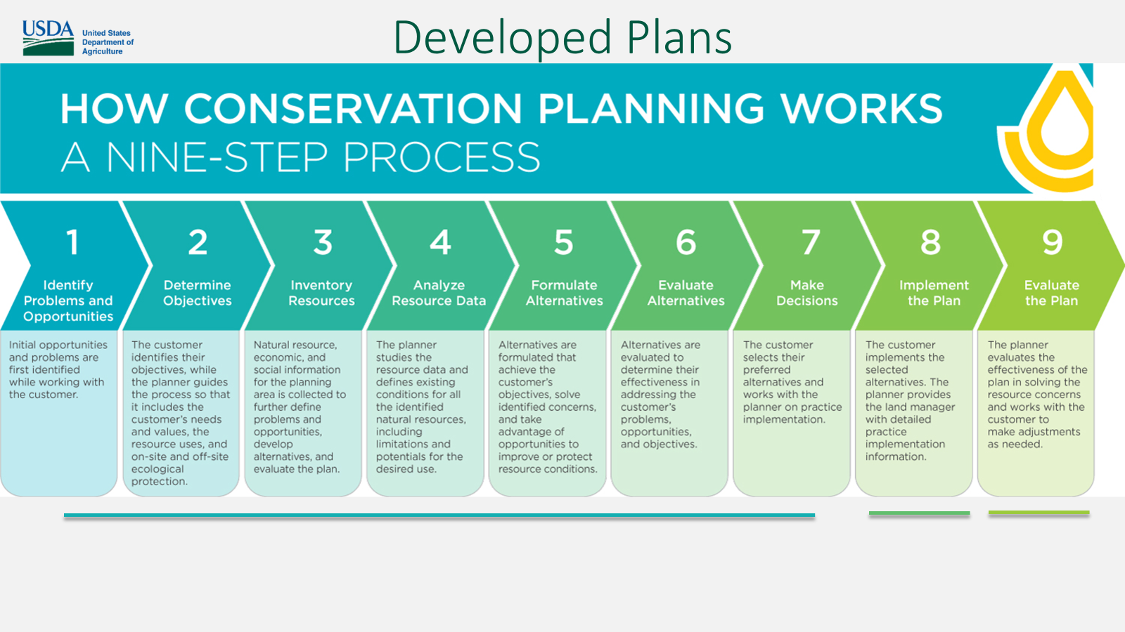
Forests are working lands
Mitigating Resource Concerns
Our forests are working lands- but in order to keep them working the health of the soil must be managed during operations in the forest.
Notes:
Steps 1-7 are critical for management of our soil health resources. Regardless of land use- working through the steps will help NRCS staff provide good alternatives to our landowners and managers.

Slide 23
Thank you!
For more information on Managing Soil Health,
visit us here:
https://www.nrcs.usda.gov/conservation-basics/natural-resource-concerns/soils/soil-health
USDA is an equal opportunity provider, employer, and lender.

